Slide 1
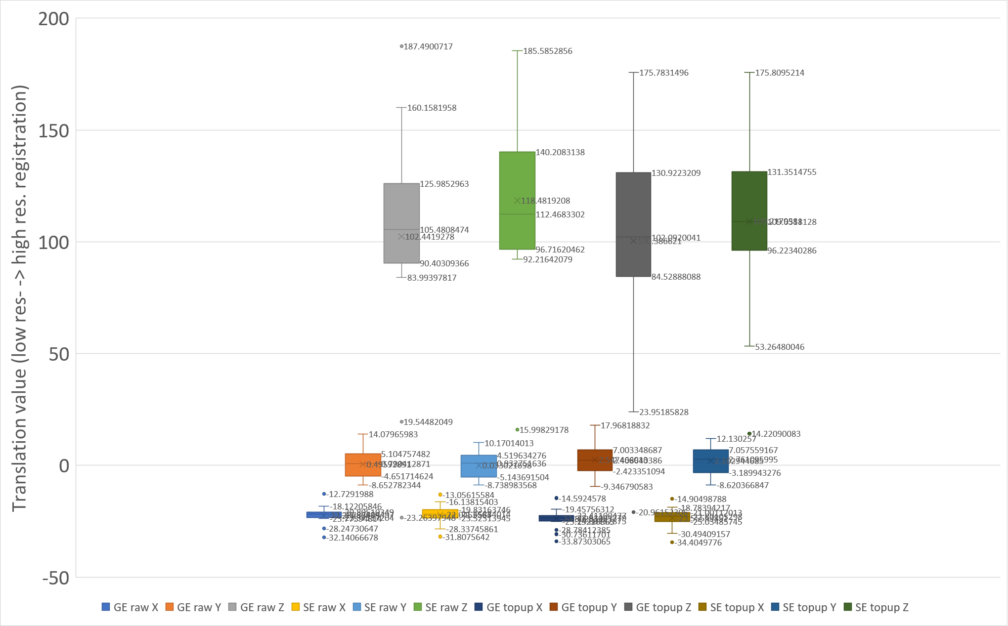

Slide 2
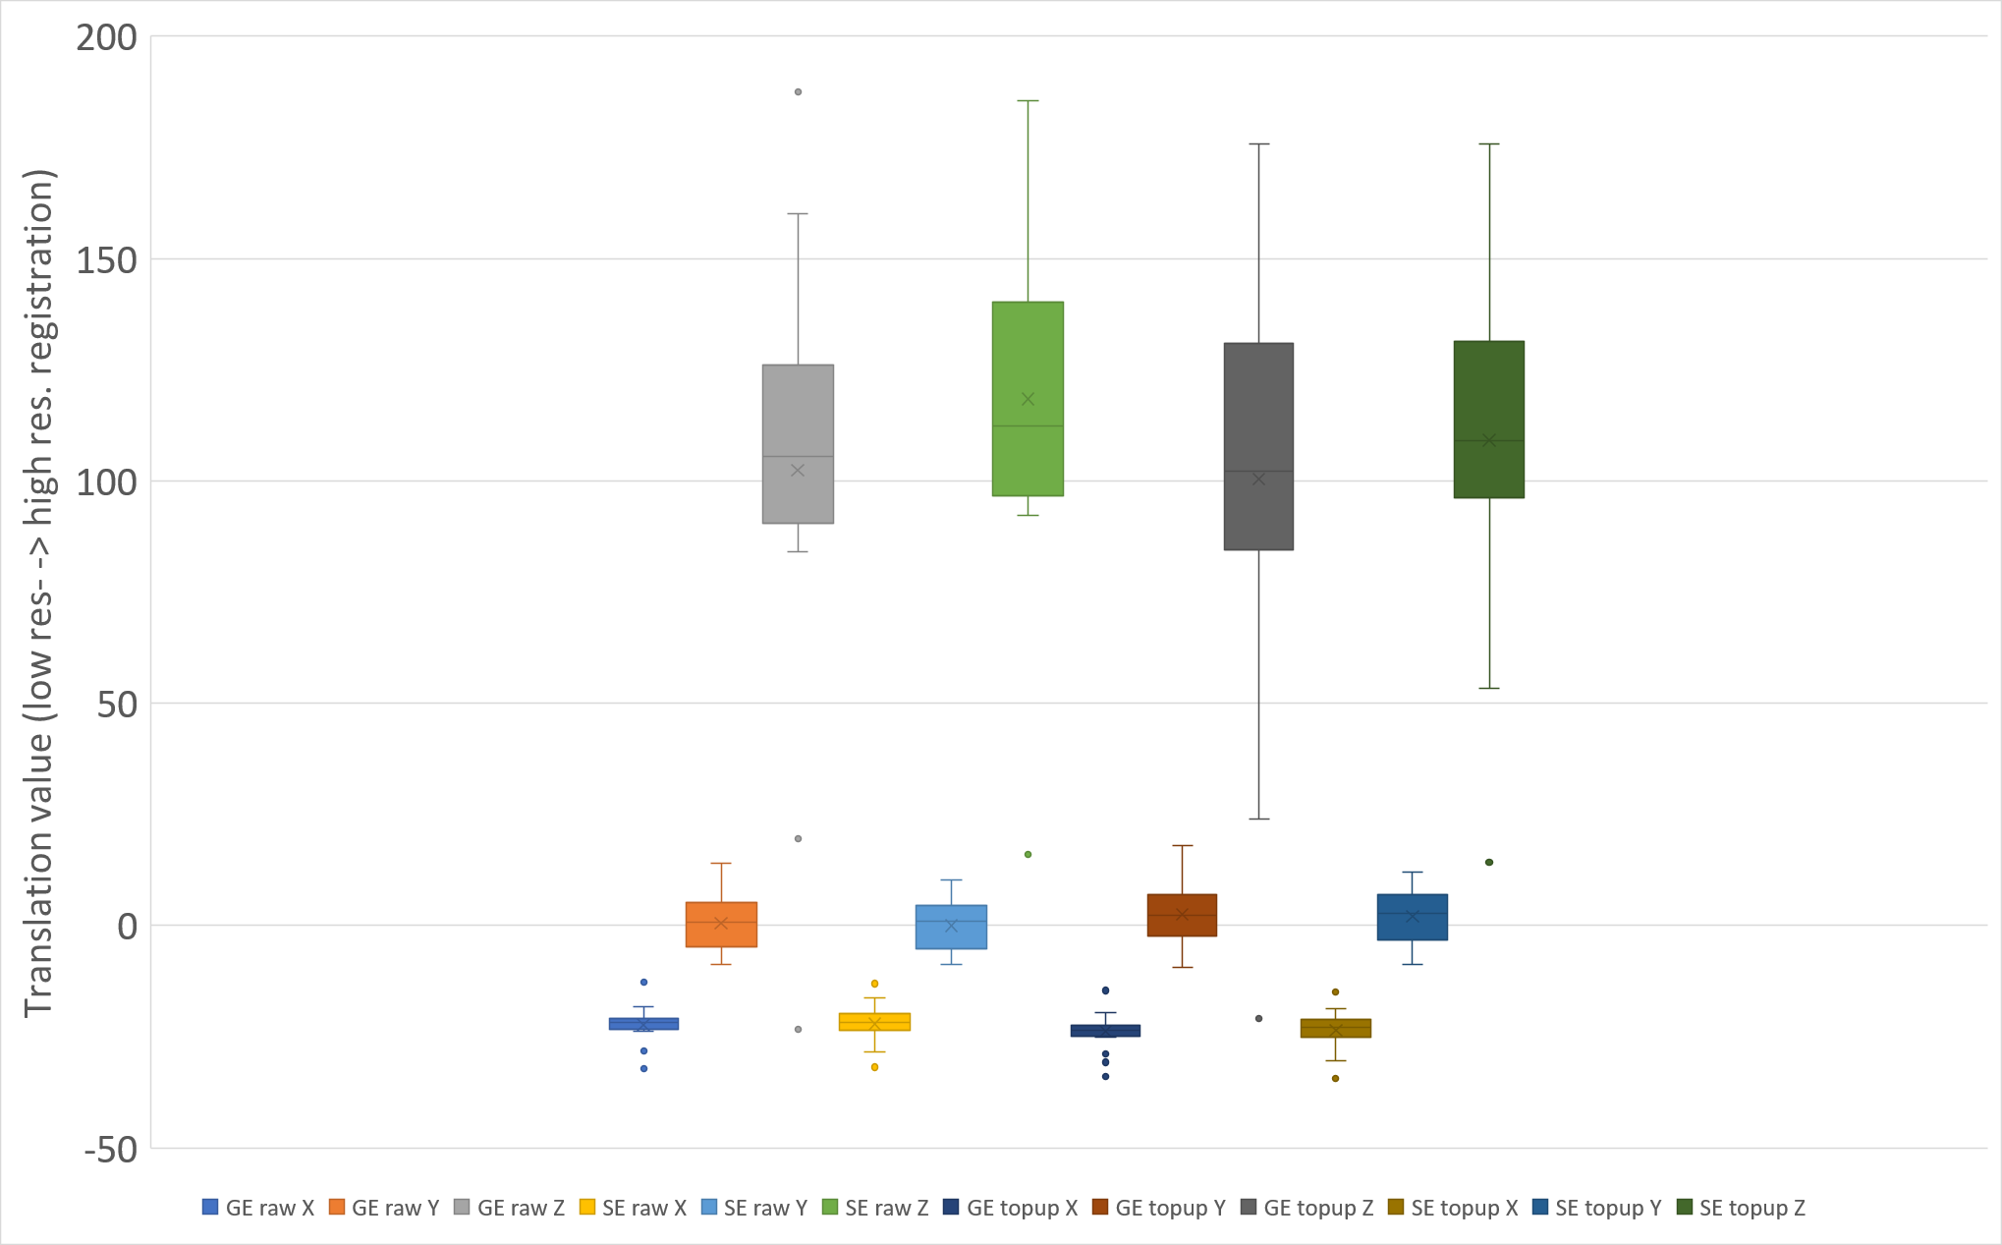
(a) GE not corrected
(b) SE not corrected
(c) GE FSL topup corrected
(d) SE FSL topup corrected

Slide 3
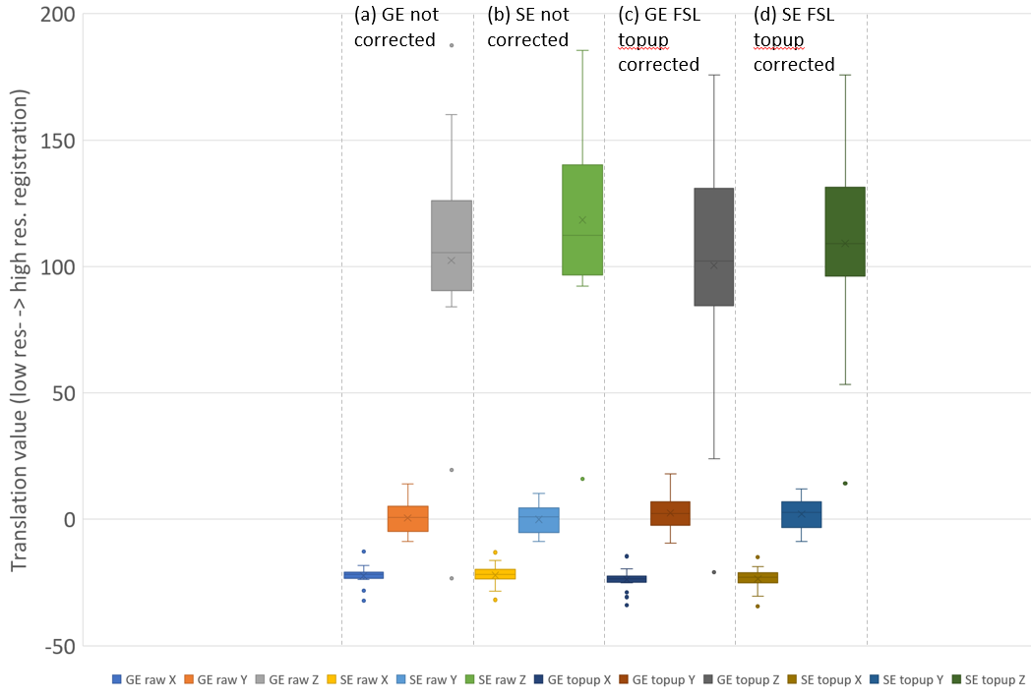
Figure 2

Slide 4
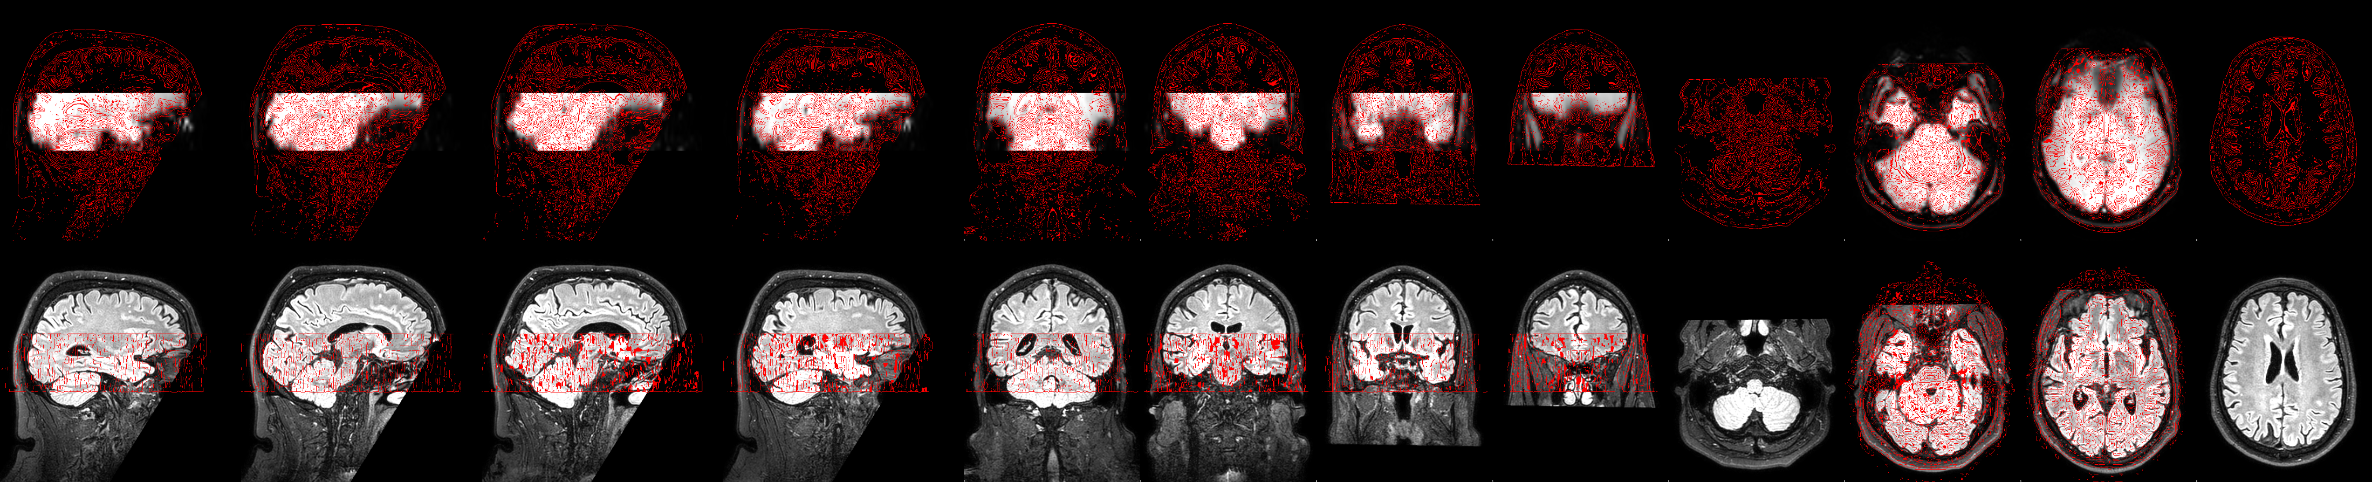
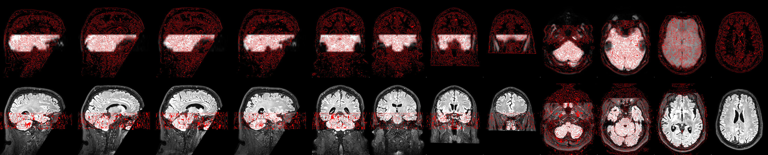
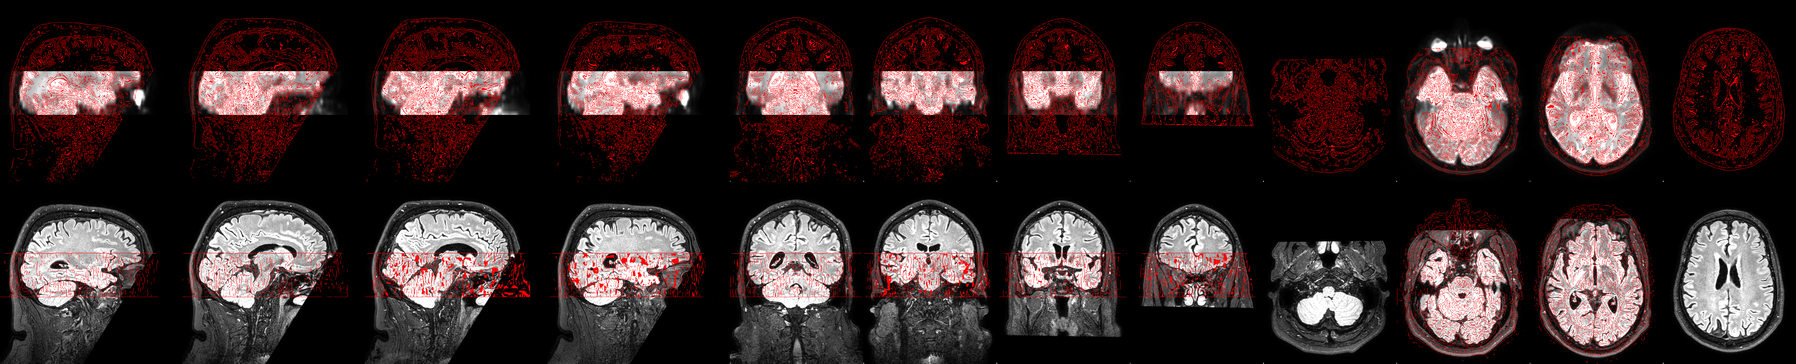
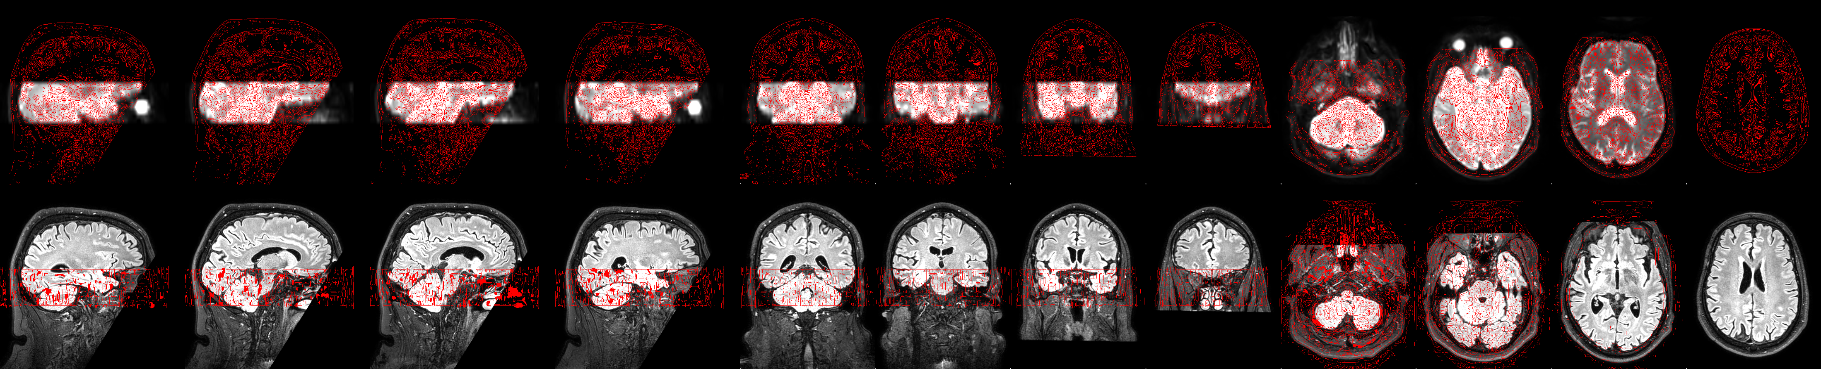
(a) GE raw reg.
(b) GE FSL topup reg.
(a) GE raw reg.
(c) SE raw reg.
(d) SE FSL topup reg.

Slide 5
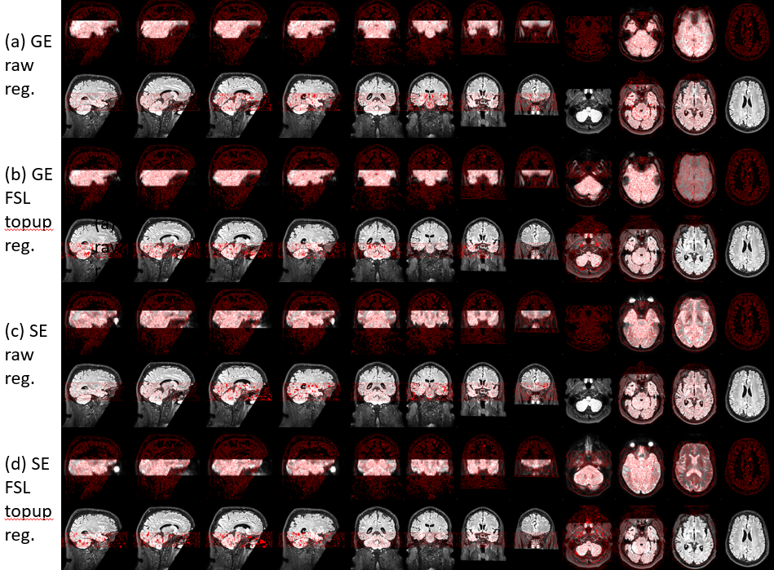
Figure 1

